Slide 1
BOSTON Crime Analysis

Slide 2
Objective:
Crime related incidents are provided by Boston Police Department. They are available on Boston dataset.
We will use this dataset to gain insights into the types of crimes that takes place in Boston and analyze it’s patterns.

Slide 3
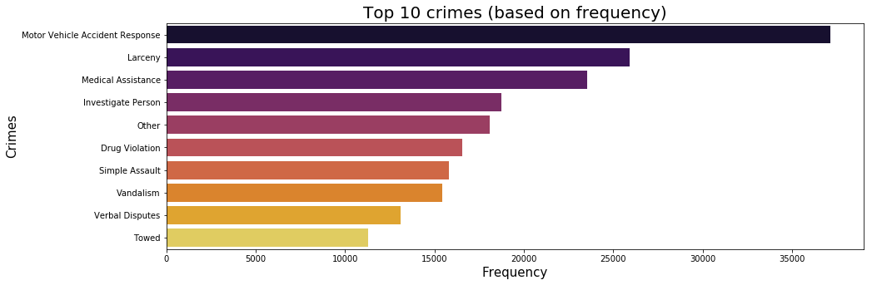
BPD have recorded 67 different unique crimes. However, we will focus on top 10 crimes that occur on a daily basis and will start analysing them.

Slide 4
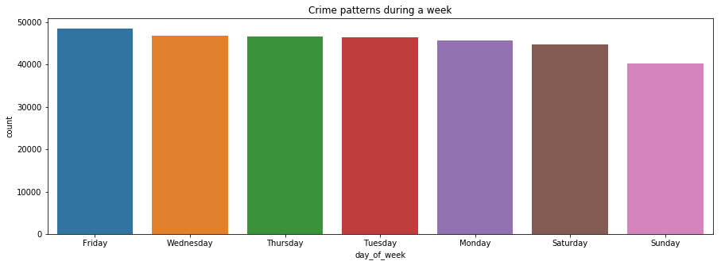
From the initial EDA, we can see that the crime rate is high on Fridays. Let's explore more on what types of crimes are committed on Fridays and we also see when do these crimes occur.

Slide 5
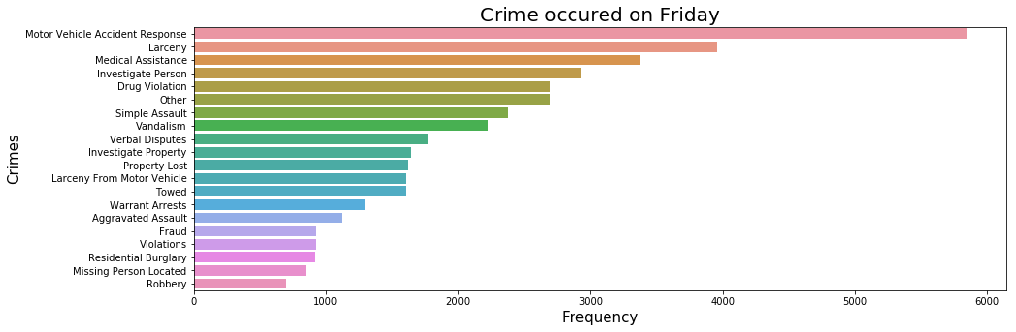
From the top 20 crimes, we can see that 'Motor Vehicle Accident Response' is listed as most occured crime followed by Larceny and 'Medical Assistance'.
Upon further analysis, I found that Motor Vehicle Accident Response is a category for all accident, fleeing from the scene of the crime, property damage and so on are listed as Motor Vehicle Accidents.
Similarly, Medical Assistance Crime - crimes involved in sudden death (death investigation), animal control (dog bite), suicide attempts and so on are listed as Medical Assistance.

Slide 6
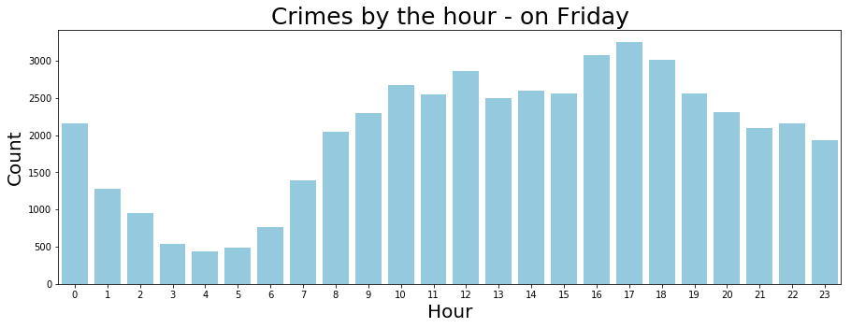
As we can see that most of the crimes are committed between 12 PM - 8 PM. Let’s see what types of crimes are committed between the time period.

Slide 7
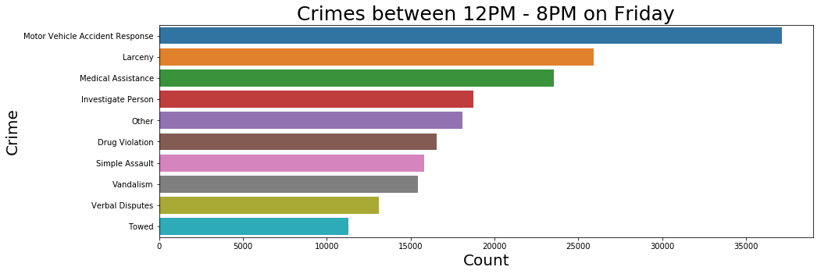
From the analysis we can determine that 'Motor Vehicle Accident Response', 'Larceny', and 'Medical Assistance' are on top of the list.
We will go ahead and investigate M/V Accident, Larceny and Medical Assistance related crimes..

Slide 8
Accident Data Analysis

Slide 9
Analysis For Motor Vehicle Accident Response:
By analysing the M/V related offences, we were able to determine that there are 10 crimes categorized under M/V category.
The top two crimes include property damage and personal injury (both involved leaving the scene of the crime).
Using this information, we will identify the areas most affected.

Slide 10
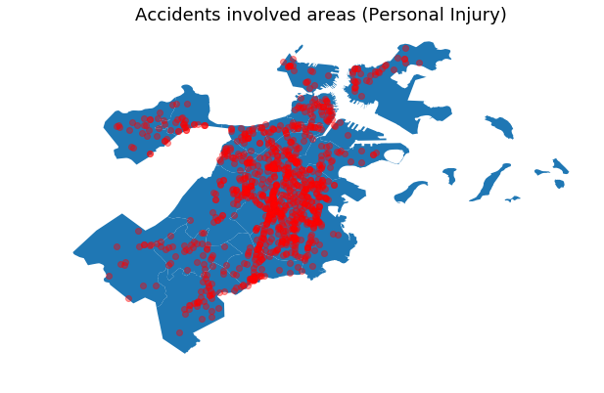
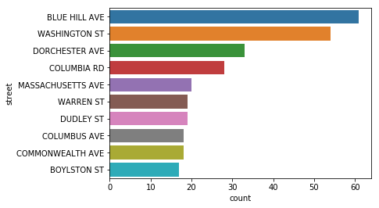
We can see that crimes related to personal injury are spread across Boston. However, streets like Blue Hill Ave, Washington St and few more has the highest concentration of M/V related incidents.

Slide 11
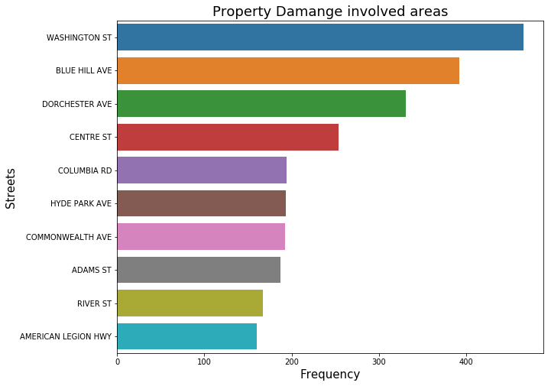
Due to data limitation, I am unable to use maps feature. However, from the image, we can identify the top 10 areas that reports property damage related crimes.

Slide 12
Larceny Crime Analysis

Slide 13
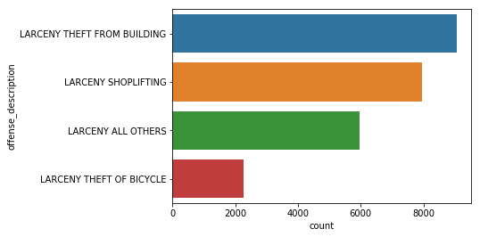
Initially, we found that Larceny holds 2nd place among the top 3 crime categories in Boston. However, after exploring the data, I found that these four crimes puts the Larceny category on the list.
The rest of the crimes like pickpocketing & purse snatching occur very rarely (less than 500 times in three years).
So, we will explore which areas in Boston are affected by these crimes.

Slide 14
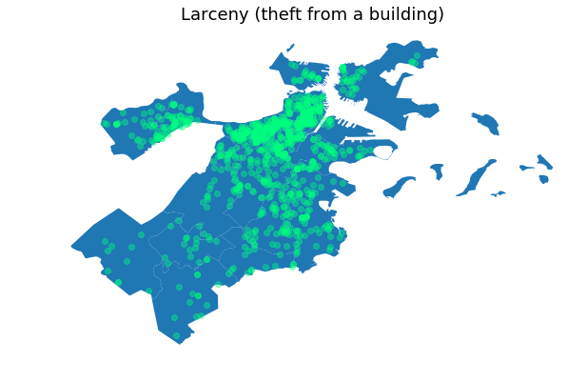
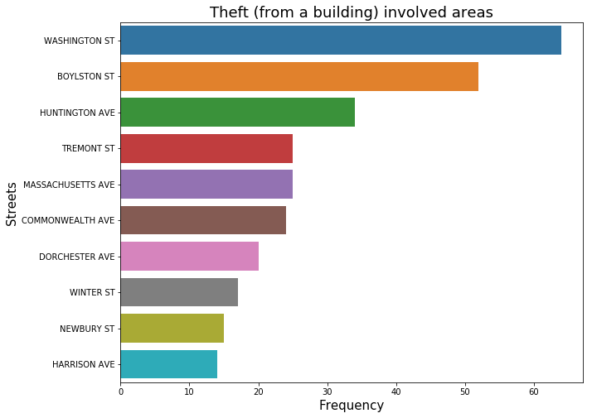
From the image, we can see that most of the larceny related crimes occur north of Boston. A quick Google search (image 1, image 2) revealed that most of the Bostons commercial real estate is focused near the north.

Slide 15
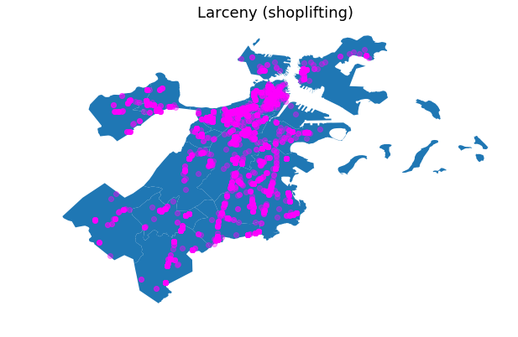
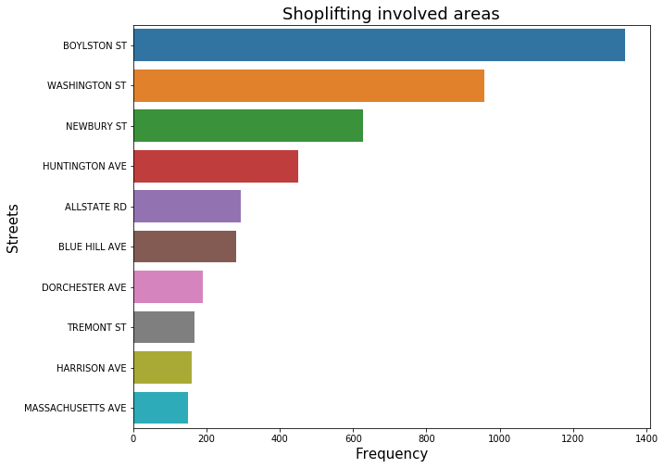
We can see that the shoplifting is also focussed to the north part of the state.
Boylston St and Washington St are two areas that were affected the most by larceny related crimes.

Slide 16
Medical Assistance Analysis

Slide 17
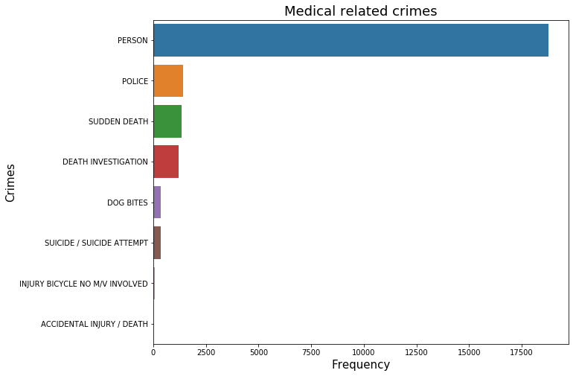
By analysing the data, we can see that most of the cases are related to ‘Person’ category. Upon, further analysis, I found out that when a person is sick/injured/requires medical attention categorized under ‘Person’.

Slide 18
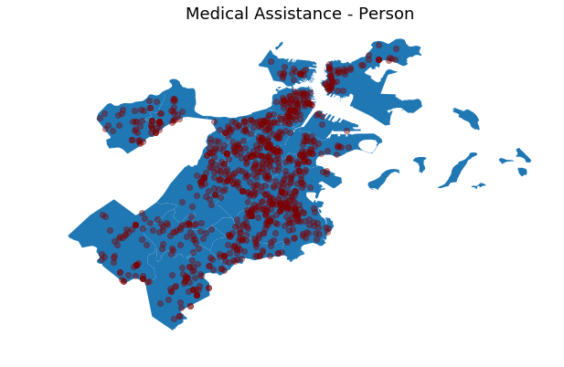
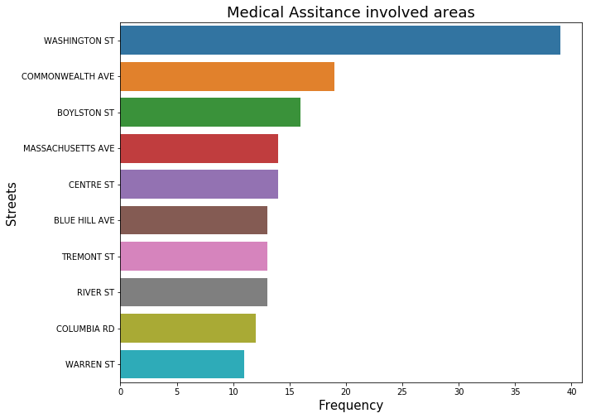
This map shows the areas where medical assistance was requested between 2015 - 2018.

Slide 19
Shooting involved Crimes

Slide 20
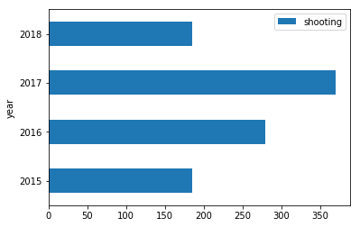
Analysis:
I wanted to analyze shooting related incidents separately. So, I have excluded incidents where shooting was involved.
Between 2015 - 2018, 1019 cases involving shooting were reported. 370 cases alone were reported in 2017.

Slide 21
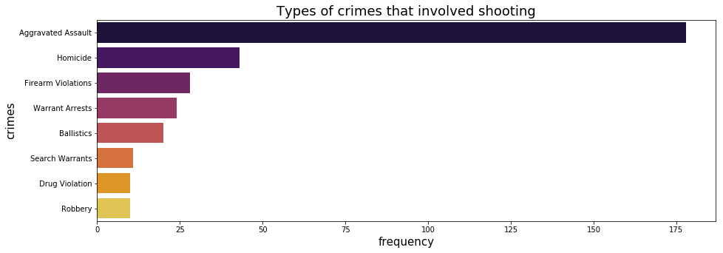
We can see that aggravated assault and Homicide are a common occurrence with shooting related incidents.
Next, we will explore areas that are affected by assault and homicide followed by areas in boston where an incident (shooting) took place.

Slide 22
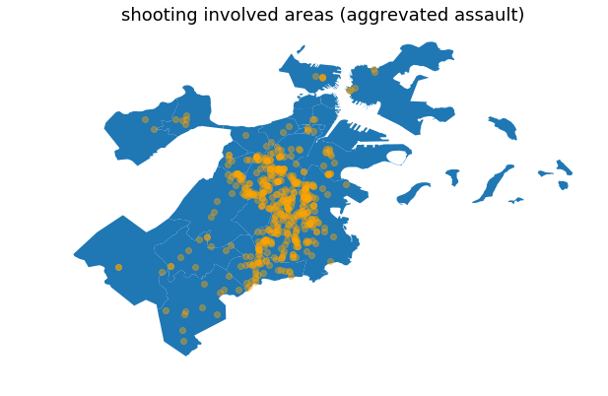
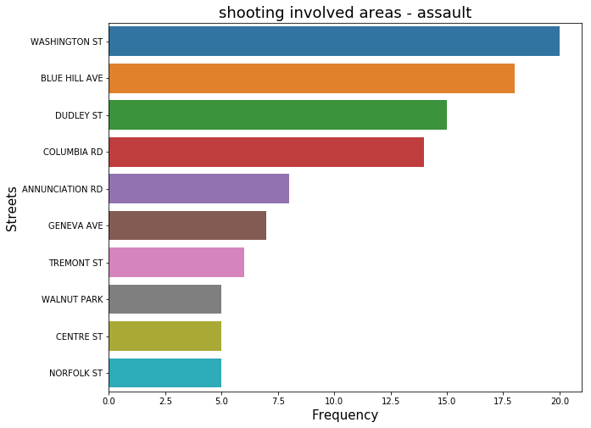
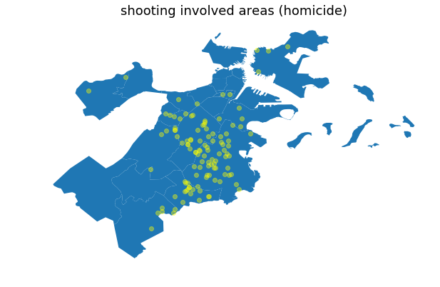
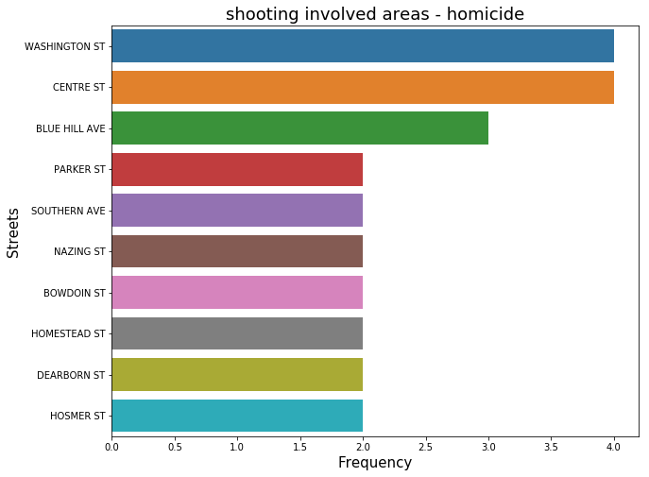

Slide 23
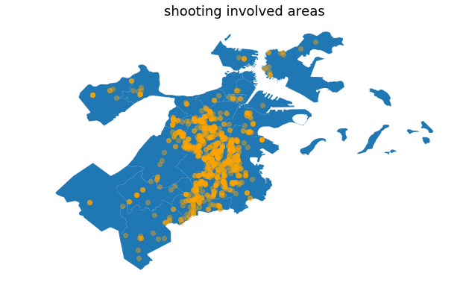
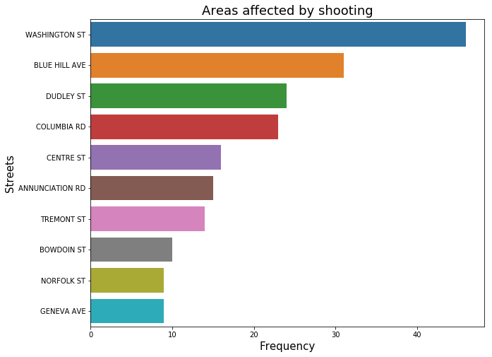
Looking at the data for shooting related incidents, we can understand that year 2017 recorded highest number of shooting related incidents in the span of 3 years.
Also, homicides didn’t vary much (from geographical standpoint). Many streets reported the same number of homicides in the year 2017.

Slide 24
Conclusion:
Between 2015 - 2018, 319073 cases were recorded by Boston PD (67 unique crimes). Most of the crime occurs on Fridays between 12 PM - 8 PM . Serious crimes are most likely to occur on Friday and least likely to occur on Sunday.
Total crimes between 2015 - 2017:
37132 - Motor Vehicle related accidents.
25935 - Larceny
23540 - Medical Assistance
1019 - shooting related incidents.
Based on the EDA, we can conclude that most of the crimes in Boston are Motor Vehicle related accidents.

Slide 25
Thank you.

